Slide 1
Worldwide COVID-19 Vaccination Trends & Progress Project 1 – Group 0
Mary Scruggs & Michelle Johnson

Slide 2



Project Scope
Objective
Our project focuses on uncovering immerging patterns in vaccinations being distributed worldwide. We will analyze relationships between vaccine types or mixes and vaccination rates (progress) by country. Lastly we’ll document observations on general global progression.
Questions Answered
People fully vaccinated by country (count & ratios)
2. Which vaccines and mixes are being distributed the most and the least (by count & ratio)
Data Source
Data Source URL: kaggle.com/gpreda/covid-world-vaccination-progress
3. What is the general global progression of people fully vaccination. & How does that compare to the top countries leading in vaccinations.
Country
Date
Total # of people fully vaccinated
Total # of people fully vaccinated per hundred
Data Dictionary
Vaccines - Vaccine name(s) used at Country level.
Notes:
Define the core message or hypothesis of your project.
Describe the questions you asked, and why you asked them
Describe whether you were able to answer these questions to your satisfaction, and briefly summarize your
findings
ALSO: Elaborate on the questions you asked, describing what kinds of data you needed to answer them, and where you
found it

Slide 3
Data Exploration & Clean Up
Consisted of
Removing any NAN from data set
All decimals
Deleted Column that stored source
Verified data types in data frame
Created new CSV file with clean data to import into analysis workbook
Resource: Jupiter Notebook 1
Note: Data as of xx/xx/xxxx

Slide 4
Analysis Process
Consisted of:
Read the new cleaned data file into notebook
Created new DataFrame with specific columns
Filtered out zeros where needed
Grouped variables as needed to perform functions (e.g. sum, max, counts)
Converted data types as needed (e.g. date / time conversion)
Sorted values as needed.
Placed results in new DataFrames to graph values.
Graphed results in bar and line charts
Resource: Jupiter Notebook 2
Note: Data as of xx/xx/xxxx

Slide 5
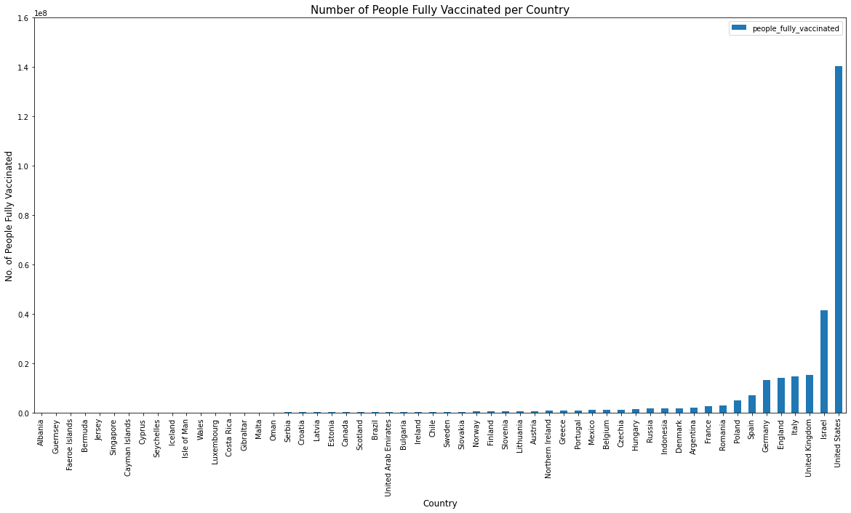
COVID-19 Vaccination Leaders – by Country
Top 5 Countries by Count
United States
Israel
United Kingdom
Italy
England
The US leads total people fully vaccinated in terms of counts by at least 3x it’s nearest ranking county (Israel)
Note: Data set is from 12/13/20 through 2/11/21. Results reflected are as of 1/10/20 which is the first date countries began reporting fully vaccinated persons.

Slide 6
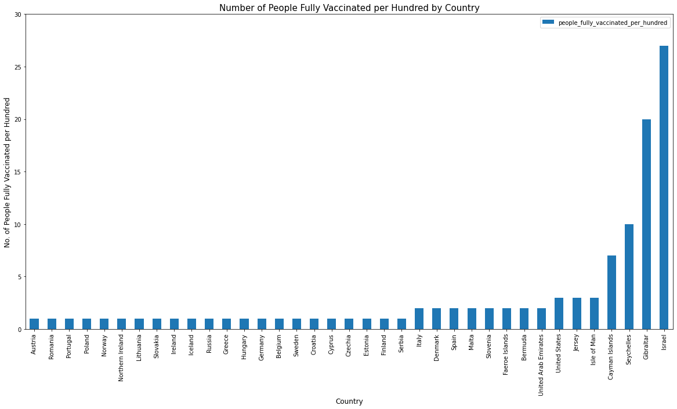
COVID-19 Vaccination Leaders – by Country
Top 5 Countries per 100
Israel
Gibraltar
Seychelles
Cayman Islands
Isle of Man
Israel: 27 per 100
United States: 3 per 100
Early on, countries are showing significant progress over others. Israel is vaccinating 9x more compared to the US.
Note: Data set is from 12/13/20 through 2/11/21. Results reflected are as of 1/10/20 which is the first date countries began reporting fully vaccinated persons.
Notes:
United States fell from 1st to 7th
Italy from from 4th to 15th

Slide 7
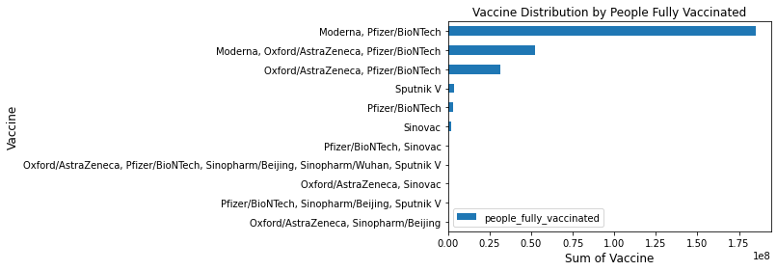
COVID-19 Vaccine types & mixes most distributed worldwide
Moderna and Pfizer/BioNTech lead the race in total number of people fully vaccinated.
Least: Sinopharm / Beijing, Sputnik V, and Sinovac

Slide 8
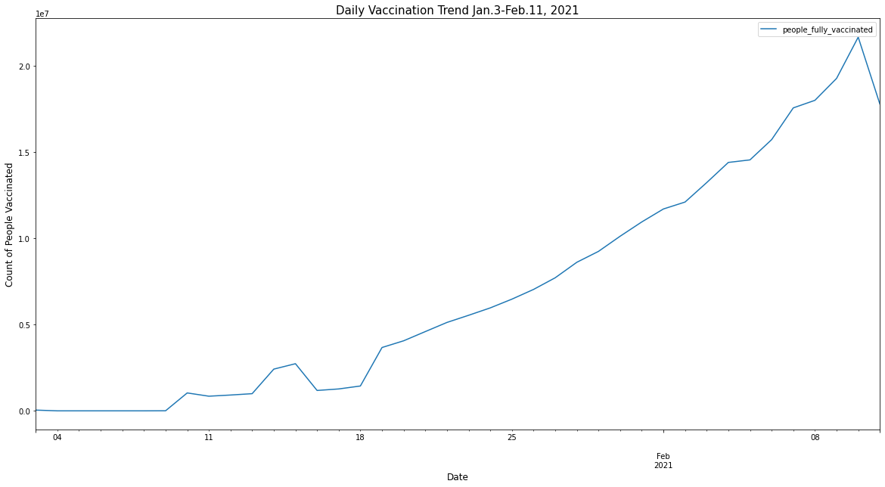
Total People Fully Vaccinated Worldwide
As of January 19th, the total number of people fully vaccinated has been steadily increasing.
More than 278 million people have been fully vaccinated as of the end of this data set. That’s only 4% of the world population.

Slide 9
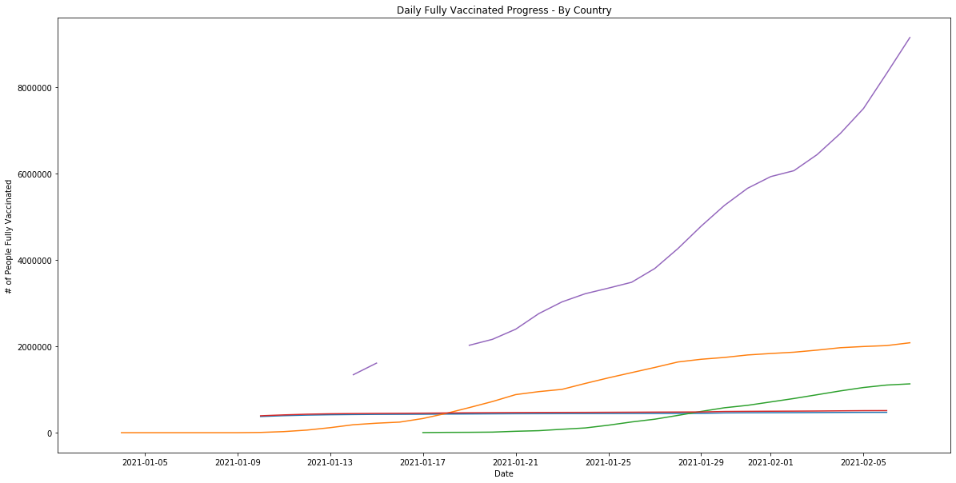
Total People Fully Vaccinated Worldwide | Top 5 Countries
Although the U.S. had a later start, we are making significant improvements daily.
U.S.
UK
Israel
England
Italy

